Slide 1
Data-driven Decision Making
Emanuele Della Valle
Prof. @ Politecnico di Milano & Partner @ Quantia Consulting
Marco Balduini
Founder & CEO @ Quantia Consulting

Slide 2

Emanuele Della Valle
Assistant Professor at DEIB | Politecnico di Milano
Founder & Partner at Quantia Consulting
Expert in semantic technologies and stream computing
Brander of stream reasoning: an approach to master the velocity and variety dimension of Big Data
+20 years experience in innovation and research projects
Contact
emanuele.dellavalle@quantiaconsulting.com
@manudellavalle
http://www.quantiaconsulting.com
http://emanueledellavalle.org
http://streamreasoning.org

Slide 3

Marco Balduini
PhD in CS | Politecnico di Milano on stream reasoning
Founder & CEO at Quantia Consulting
Expert in data processing, data integration and data science technologies
~10 years experience in innovation and research projects
Contact
marco.balduini@quantiaconsulting.com
@balducci85
http://www.quantiaconsulting.com

Slide 4
Taking Decisions
In many organizations decisions are made by "questionable" methodologies such as

Slide 5
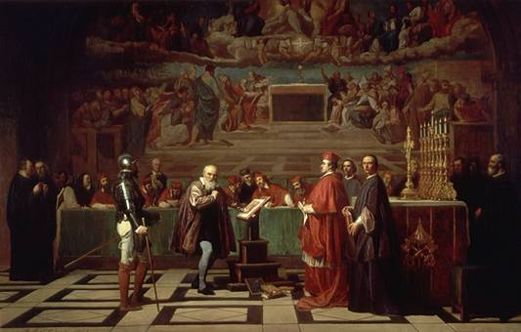

Taking Decisions: HiPPO
Galileo before the Holy Office by Joseph-Nicolas Robert-Fleury
Geocentric model in a Luther Bible (1545)

Slide 6

Taking Decisions: Flipism

Slide 7
Taking Decisions (cont.)
In many organizations decisions are made by "questionable" methodologies such as
Highest Paid Person Opinion (HiPPO)
Flipism (all decisions are made by flipping a coin)
This could have been the right approach in the '70s …
See the "Theory of Bounded Rationality" by Herbert Simons

Slide 8
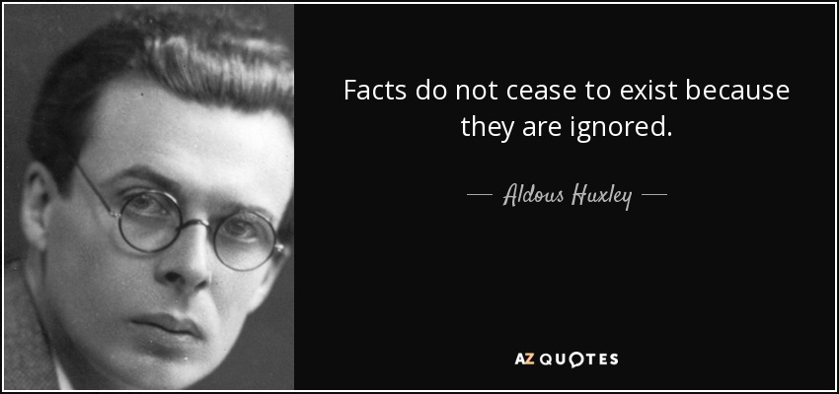
Taking Decisions (cont.)
[source http://www.azquotes.com/quote/139996 ]

Slide 9
Taking Decisions (cont.)
In many organizations decisions are made by the "questionable" methodologies such as
Highest Paid Person Opinion (HiPPO)
Flipism (all decisions are made by flipping a coin)
This could have been the right approach in the '70s …
See the "Theory of Bounded Rationality" by Herbert Simons
… but in the Digital Era one can dream of data-driven organization

Slide 10
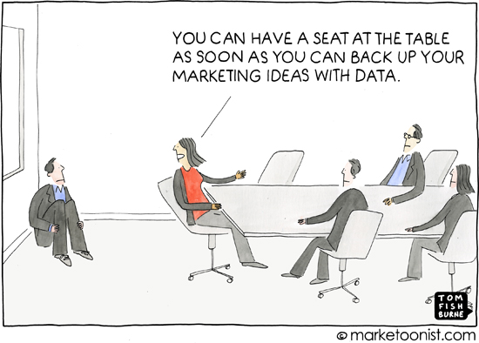
Taking Decisions: data-driven organization

Slide 11
Data-Driven Decisions
Decisions no longer have to be made in the dark or based on gut instinct; they can be based on evidence, experiments and more accurate forecasts.
-- McKinsey

Slide 12
Data-driven organizations
perform better
The data shows where they can streamline their processes
are operationally more predictable
Data insights fuel current and future decision making
are more profitable
Constant improvements and better predictions help to outsmart the competition and improve innovation.

Slide 13





It's a streaming world …
E. Della Valle
Off-shore oil operations
Smart Cities
Global Contact Center
Social networks
Generate data streams and events!
Notes:
1313

Slide 14
… looking for historical analysis …
E. Della Valle
What is the average time to failure for the different brands of turbine in use?
What is the average delay of the public transport per city district?
What is the distribution of skills among the agents in our contact centres?
Which content features are correlated to high impact posts?
Requiring the ability to store massive timeseries and process them in a scalable way

Slide 15
… struggling with reactive answers
E. Della Valle
What is the expected time to failure when that turbine starts to vibrate as detected in the last 10 minutes?
Is public transportation where the people are?
Who are the best available agents to route all these contacts about the tariff plan launched yesterday?
Who is driving the discussion about the top 10 emerging topics?
Requiring continuous processing and reactive answers

Slide 16
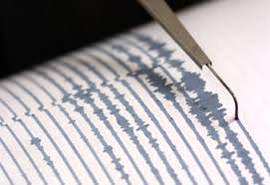
Because there are two moments to extract value from data
reactive decisions
historical analysis
Value
ms. sec. min. hours days months years
velocity

Slide 17
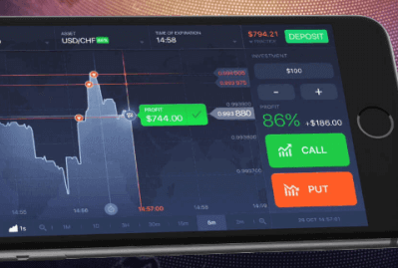
Because there are two moments to extract value from data
reactive decisions
historical analysis
Value
ms. sec. min. hours days months years
velocity

Slide 18
Because there are two moments to extract value from data
reactive decisions
historical analysis
Value
E. Della Valle
ms. sec. min. hours days months years
velocity

Slide 19
Data-driven decision
Descriptive
What happen?
Diagnostic
Why did it happen?
historical
analysis
Predictive
What will happen?
Data
Decision
Action
Decision Support
reactive decisions
Prescriptive
What should I do?
Decision Automation
[src. Gartner]
Machine-centered
Human-Centered

